Slide 1

Football Team Generator
Muhammad Shayekur Rahman
22MayEnable2

Slide 2



Agenda
Planning
Back End
Front End
Testing
Demonstration

Slide 3
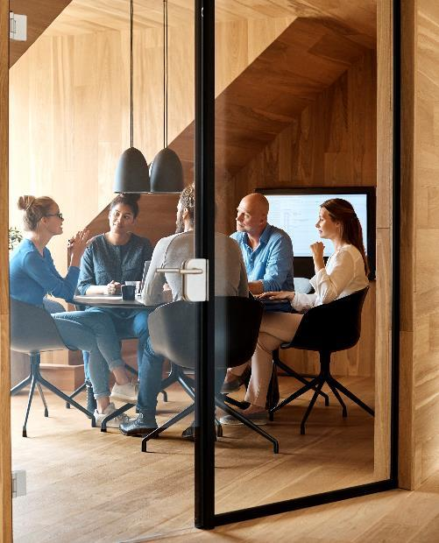



Introduction
I have built a website which allows a user to create a football team, so that they may visualize where players are positioned. This may be useful for amateur football players to organize Sunday league matches.

Slide 4

Planning
Identified user Stories.
The core functionality of a user being able to create, read, update and delete information.
Skills/Languages used: Agile, Java, Spring, HTML, CSS, JAVASCRIPT, BOOTSTRAP, Axios.
Git was used for version control. Implemented FB methodology.

Slide 5

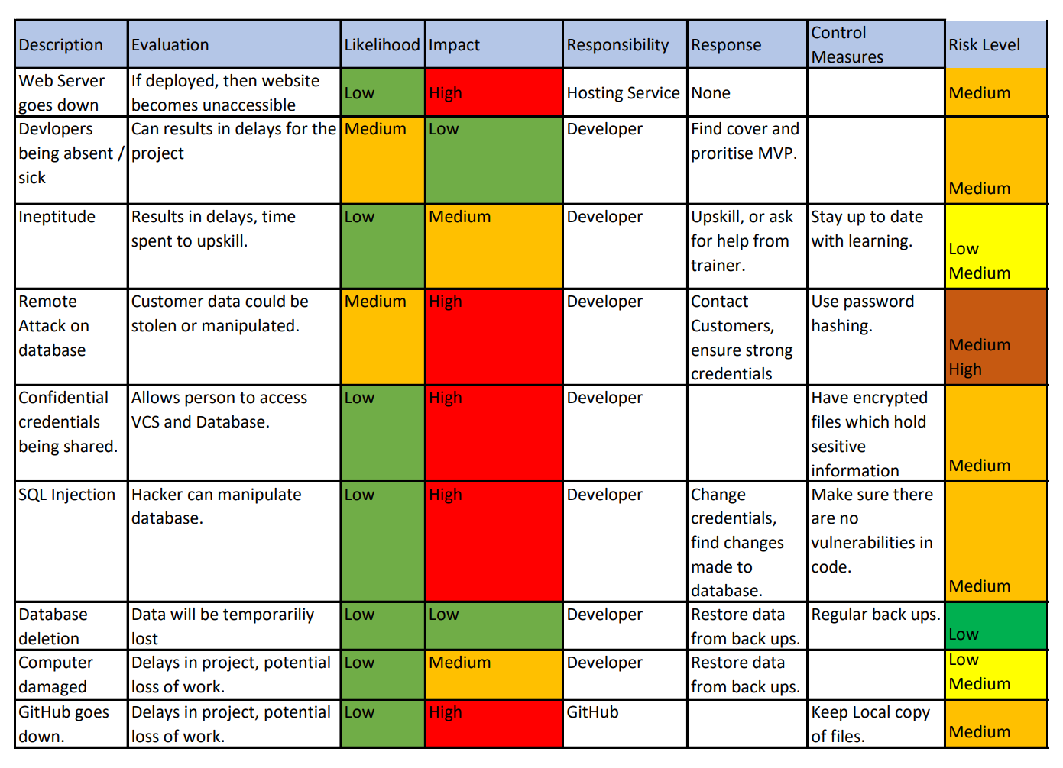
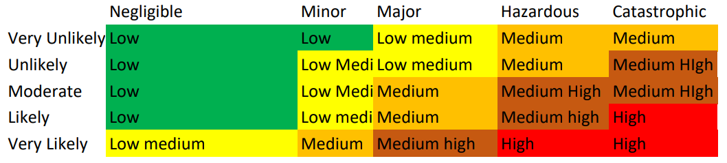
Risk Assessment

Slide 6

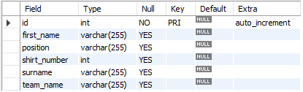
Database progression
Redesign
By creating more attributes, allowed for more creativity and user functionality as would be demonstrated.
In future: I would add a separate table for teams, so that users could have duplicate team names.

Slide 7
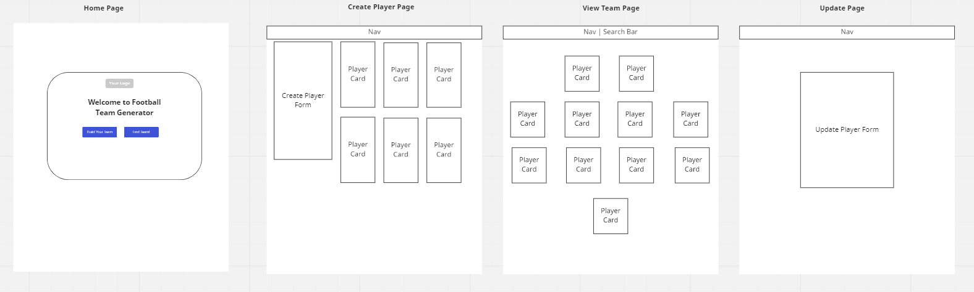
Front End - Wire Frame

Slide 8
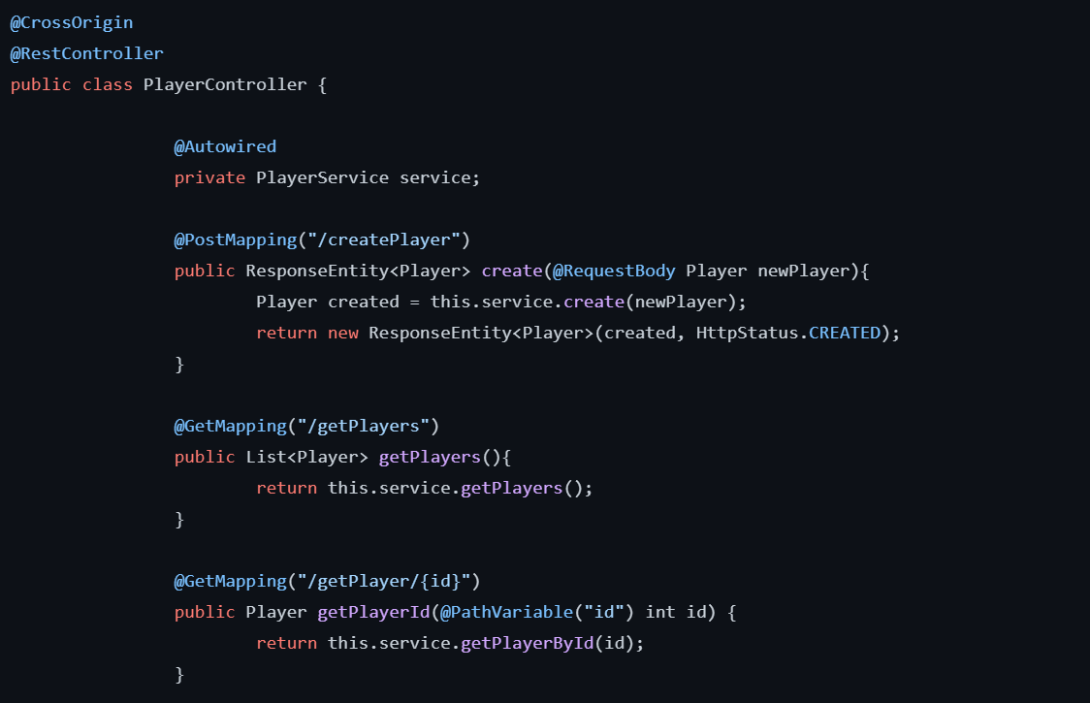
Back-End: Using Java and Spring
Here is an example of a method written in java which handles information from a request and creates an entry into the database via spring.
Using spring:
Eliminates the need to independently create factory and singleton classes;
Easy development

Slide 9
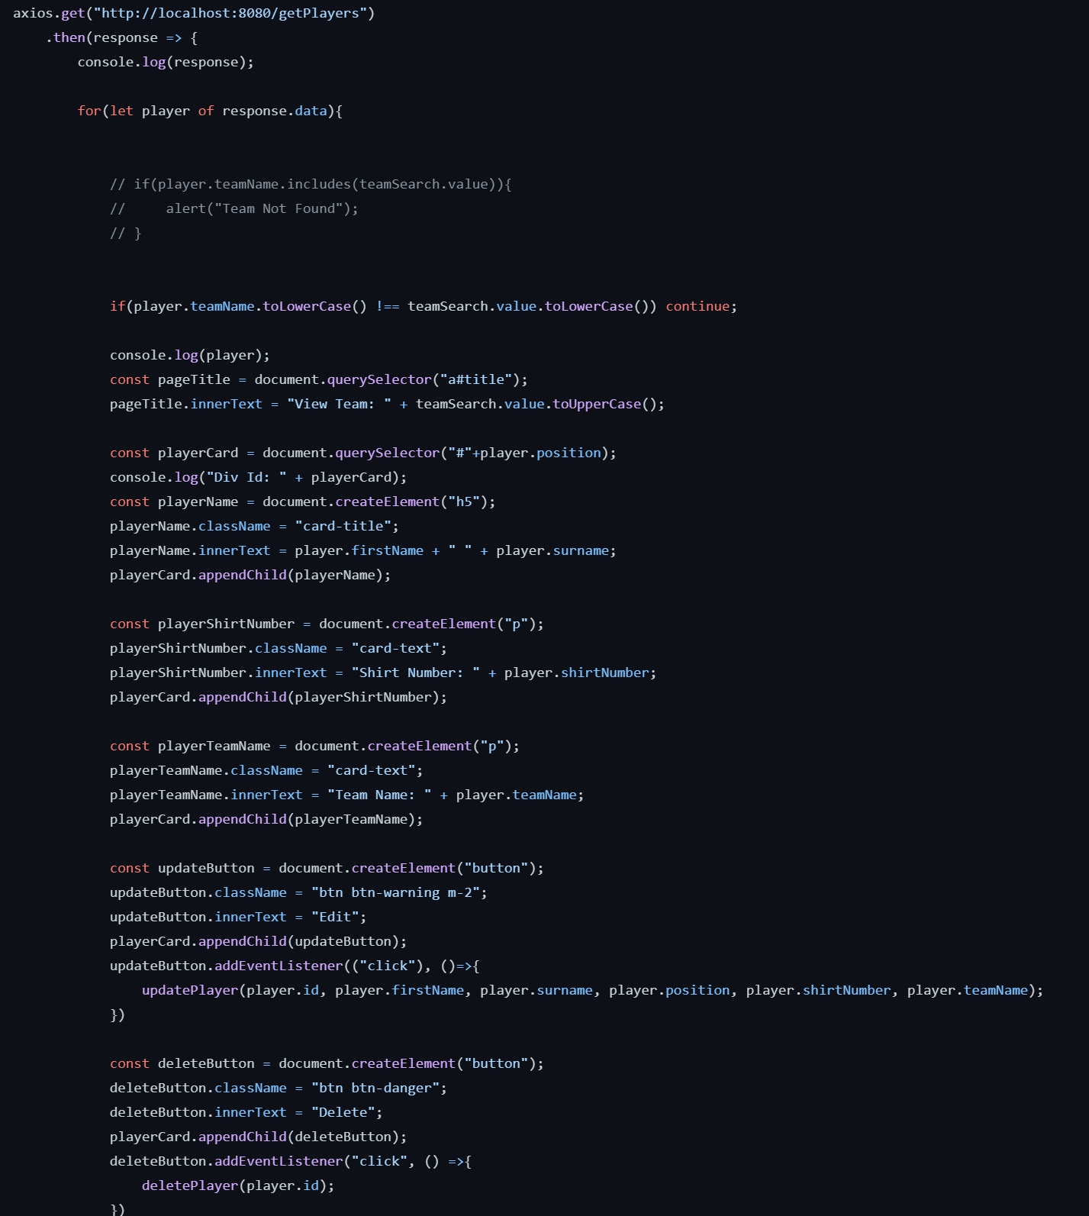
Front-End: HTML, CSS and JS
Used HTML to create the fundamental layout of page.
CSS and BootStrap were used for styling.
JavaScript was used in order to retrieve and handle information via axios and would display information onto page through DOM manipulation.
Here is an example of code which I used data in my table to refer to an element in HTML, this allowed me to display players in a formation which is useful for the user.

Slide 10
Testing
Junit
Mockito
Coverage
Add text, images, art, and videos.
Add transitions, animations, and motion.
Save to OneDrive, to get to your presentations from your computer, tablet, or phone.
Open the Design Ideas pane for instant slide makeovers.
When we have design ideas, we’ll show them to you right there.
Add text, images, art, and videos.
Add transitions, animations, and motion.
Save to OneDrive, to get to your presentations from your computer, tablet, or phone.
Open the Design Ideas pane for instant slide makeovers.
When we have design ideas, we’ll show them to you right there.
Add text, images, art, and videos.
Add transitions, animations, and motion.
Save to OneDrive, to get to your presentations from your computer, tablet, or phone.
Open the Design Ideas pane for instant slide makeovers.
When we have design ideas, we’ll show them to you right there.

Slide 11
Demonstration
Lets Build a Team!

Slide 12

Summary
I think the project went very well. I have gained a strong understanding of how a full stack web application works.
I would have liked to include a user login system, so that teams can be tied to a creator, and to also implement front end testing through selenium and sonarqube.

Slide 13


Thank You
Muhammad Shayekur Rahman
https://github.com/MuhammadShayekurRahman/Football-Team-Generato
Special Thanks to Jordan H and Jordan B.

